Slide 1
HUSKY PROJECT
Joshua Roe, Sean Katagiri

Slide 2
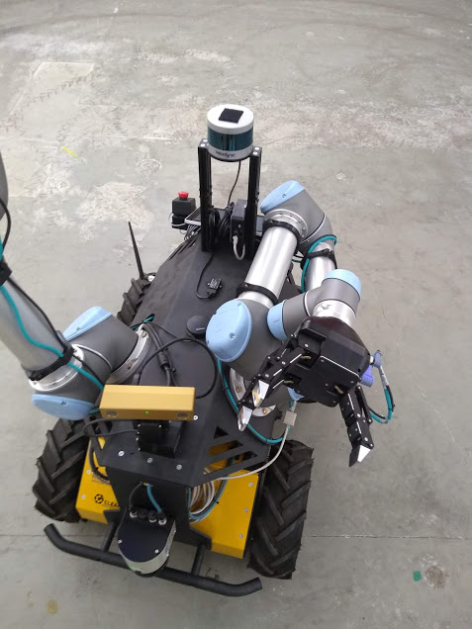
Brief – 3 weeks ago
Use husky Robot with dual mounted UR5 manipulators to visually locate an object, plan a path to collect object with manipulators.

Slide 3

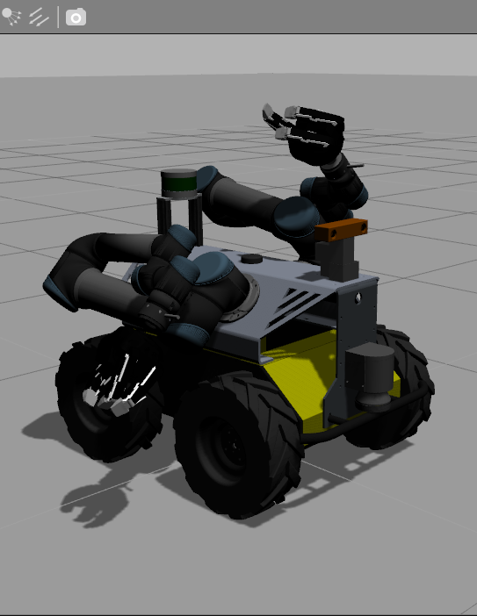
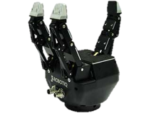
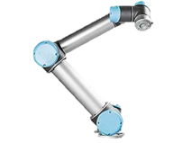
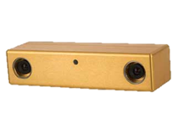
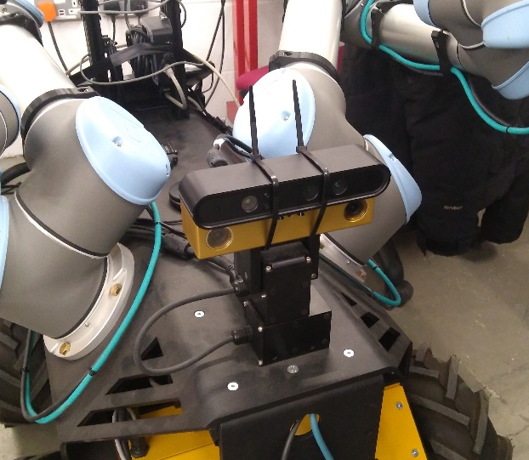
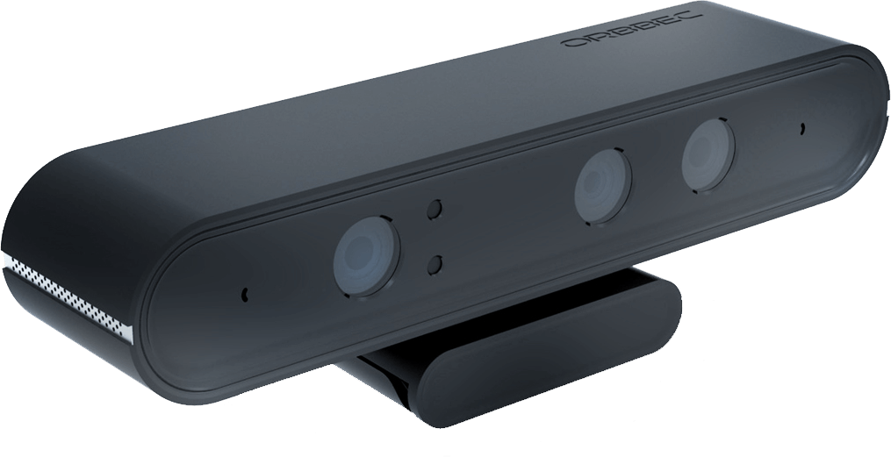
Husky A200
Astra camera – provides depth image!

Slide 4
Main goals from 3 weeks ago
The system should be able to:
Locate an object using the Bumblebee2 stereo camera and an image detection node.
map the environment and use this data to plan a path to the object.
Plan and execute manipulator movements in order to pick up the object.
Astra camera
find_object_2d
hector_mapping & move_base
moveit_planner

Slide 5
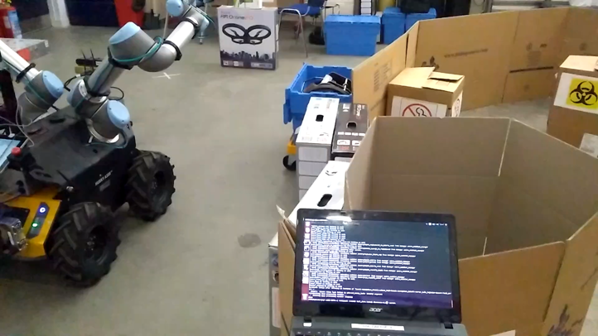
What we have achieved
Navigation to target object
Pick up target object
Return to start position with object
video link in report

Slide 6
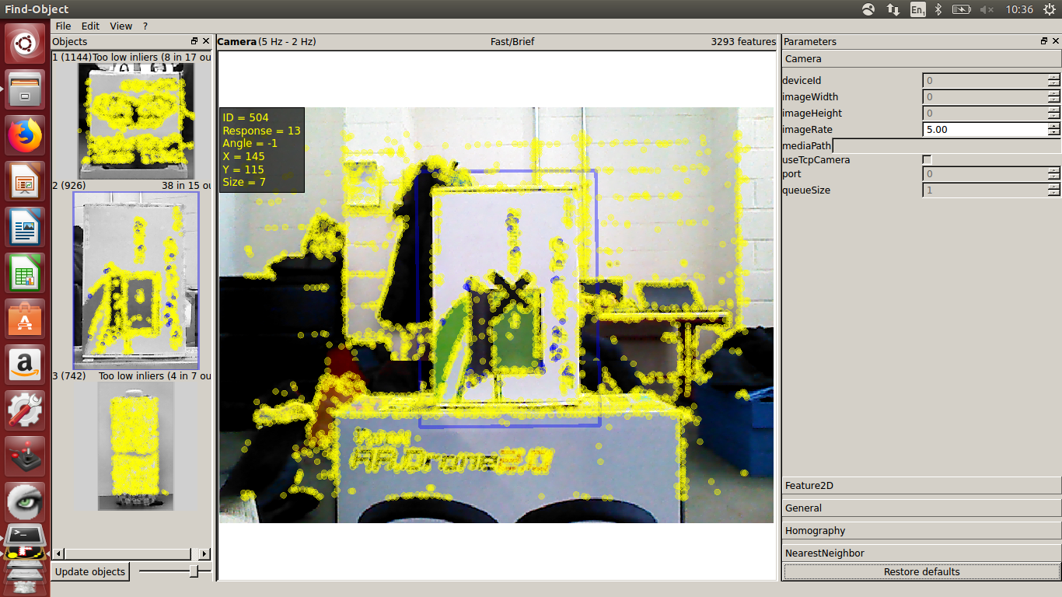
Feature detection and object recognition
Obtain image feed from astra camera.
find_object_2d finds known features by looking for features in predefined images and outputs the object pose.
TF of object created in simulated space using tf_listener between /map and /object

Slide 7
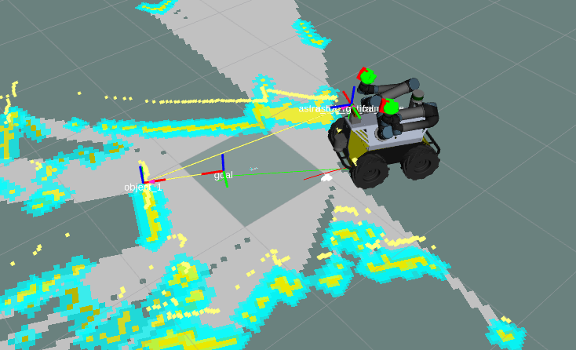
Navigation
Velodyne scan data separated from sick sensor to /scan_velodyne
hector_mapping produces map of environment
Goal transform created with static_transform_publisher from package tf
Translation and orientation from /map to /goal used by move_base action client which sets the navigation goal point.
By the end of navigation to object, it will be facing the target object face on.

Slide 8
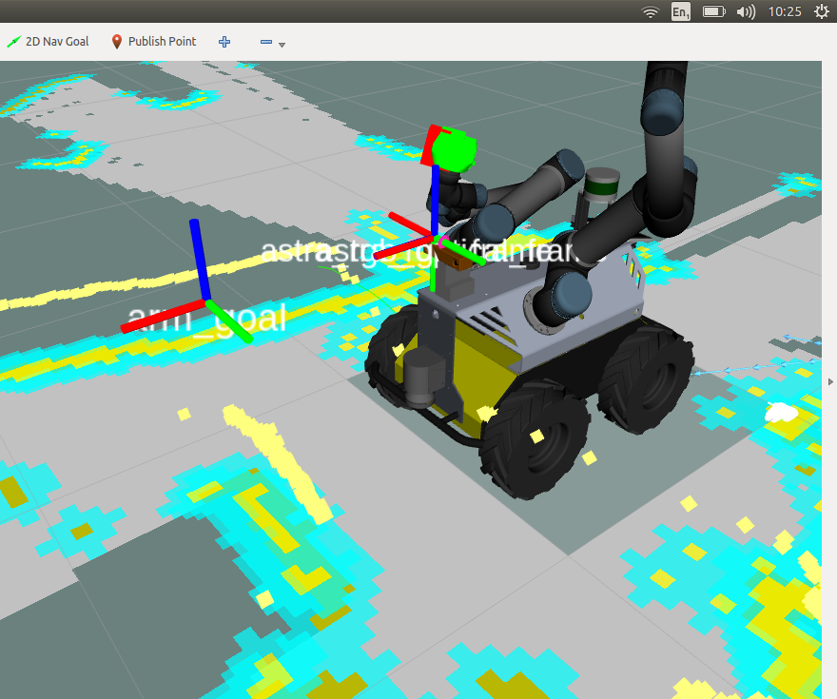
MoveIt Joint Planning
Second object detected by find_object_2d and transform created in simulated space
Startic_transform_publisher creates transform arm_goal as joint end point for planner
Moveit joint planner plans path for ur5 to arm goal
Grabs object, and returns to start position with object

Slide 9
QUESTIONS?

